Slide 1
Simulating a Quadcopter Drawing a shape
Benheddi Alaeddine

Slide 2
Project Objective
Objective: Program a quadcopter to autonomously draw a square
Objective: Program a quadcopter to autonomously draw a square
Objective: Program a quadcopter to autonomously draw a square
Objective: Program a quadcopter to autonomously draw a square
Objective: Program a quadcopter to autonomously draw a shape
Utilize PID controllers for precise position control
Capture an image using a vision sensor

Slide 3
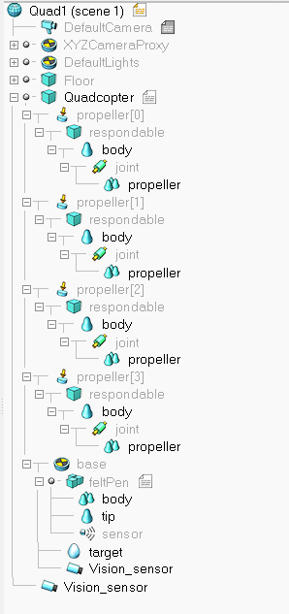

Simulation Setup
Connect to CoppeliaSim using remote API in MATLAB
Setup quadcopter, pen, and vision sensor objects
Configure simulation parameters and initial positions

Slide 4
Control Strategy: PID Controllers
Objective: Program a quadcopter to autonomously draw a square
Objective: Program a quadcopter to autonomously draw a square
Objective: Program a quadcopter to autonomously draw a square
Objective: Program a quadcopter to autonomously draw a square
precise control of both the quadcopter's position in the XY plane and its altitude
Proportional gain (Kp), Integral gain (Ki), and Derivative gain (Kd)
Tuning these parameters was crucial

Slide 5
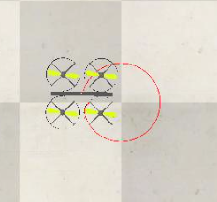
Movement Through Waypoints
Define waypoints on the XY plane
Adjust quadcopter height for drawing plane and pen tip
Iterative control loop to move through waypoints smoothly

Slide 6
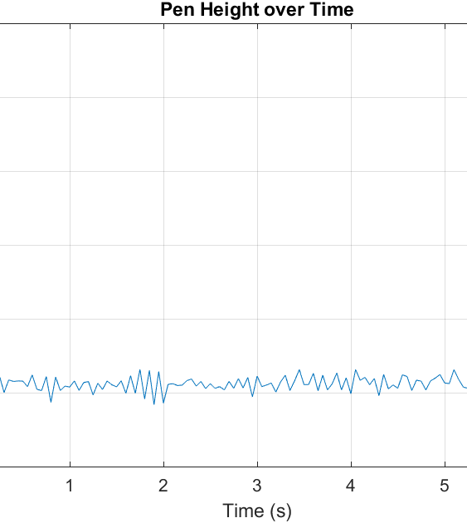
Data Collection and Visualization
Collect data: Time steps and pen height over time
Adjust quadcopter height for drawing plane and pen tip

Slide 7
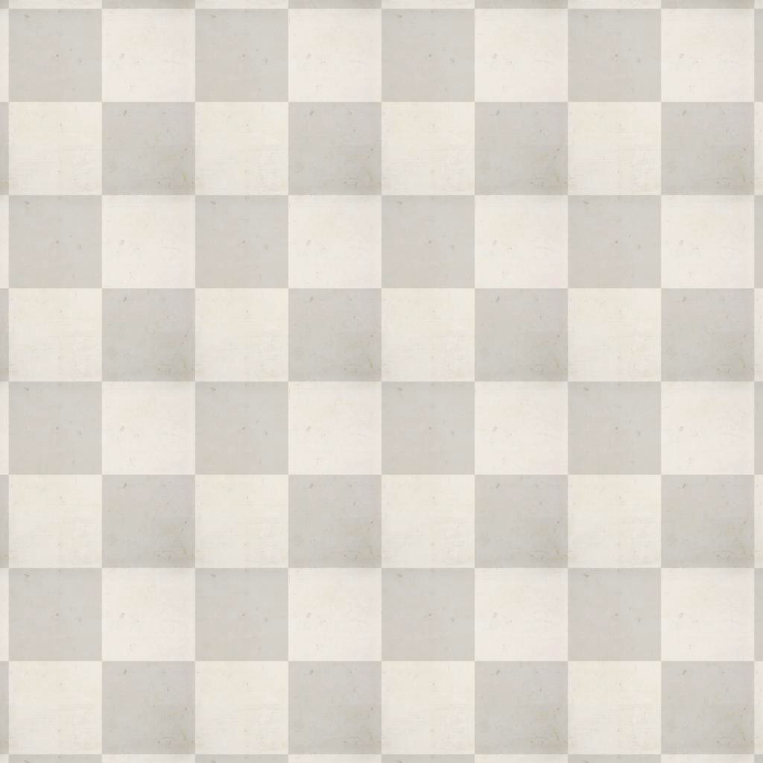
Capturing an Image and Video
Capture an Image using the Quadcopter
Record a video of the Quadcopter using vision sensor.

Slide 8
Demo

Slide 9
Thank you

